Slide 1





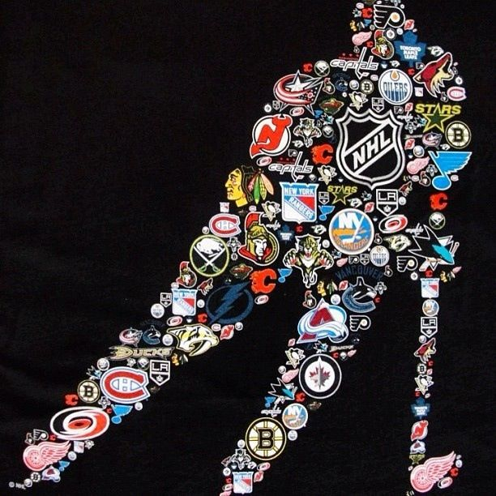



CONTACT
NXT-LVL
HOCKEY
STATS FOR THE MODERN FAN

Slide 2
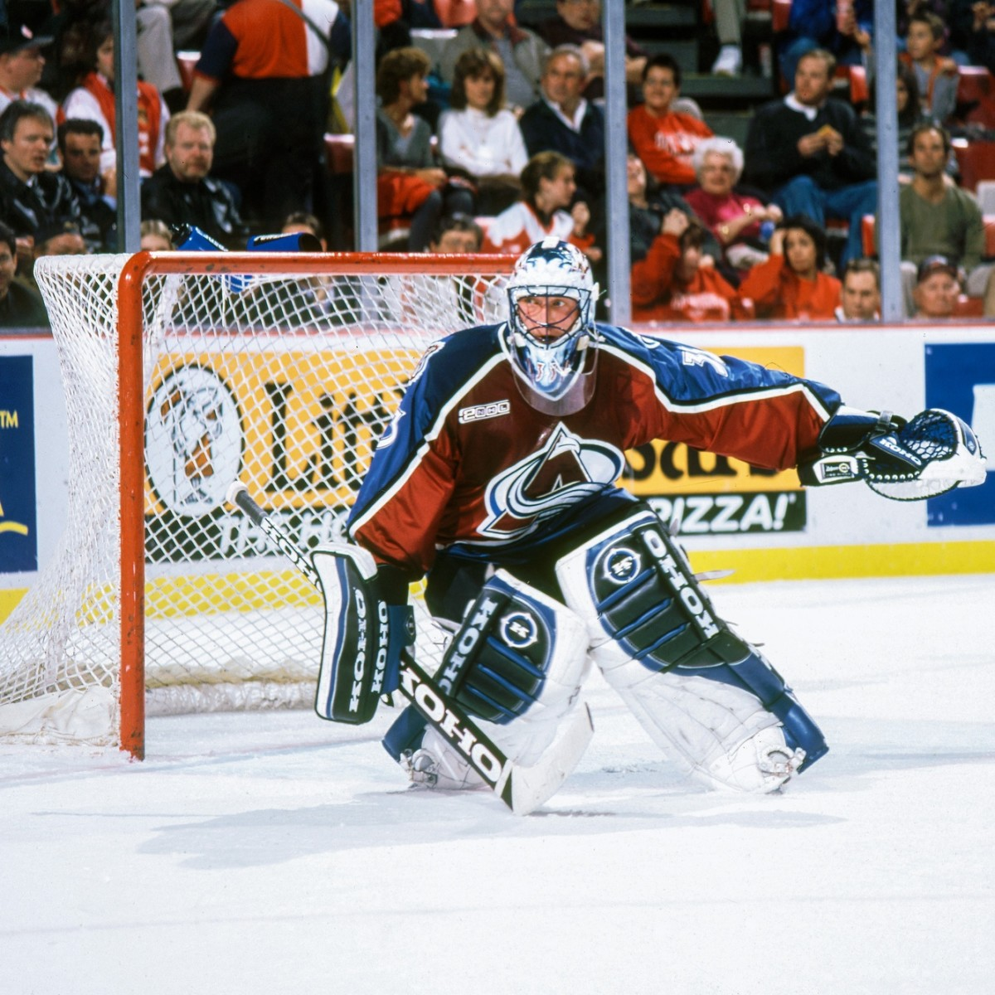

LOGO
INTRODUCTION
We’ve created a cutting-edge tool that allows the average fan to access Hockey statistics like the pros do.
The days of sifting through of data strewn across multiple websites is coming to an end. Now with just a few clicks you can access a plethora of in-depth hockey statistics about your favorite teams, players, and the league as a whole!

Slide 3





WHAT WE OFFER
Team Analysis
Accolade Overview
Every wondered what stats contribute to your favorite teams wins? NOT ANYMORE
Ever wanted instant access to data on historical trophy winners? YOU GOT IT
Player Overview
Next Level Draft
Want to put in that Parlay but not sure if your favorite player will deliver? WE HAVE THE ANSWER
Get next level draft insights on the key picks your team. OWN THE DRAFT

Slide 4

LOGO
WELCOME TO FUTURE
We’ve prepared a special sneak peek just for you.

Slide 5

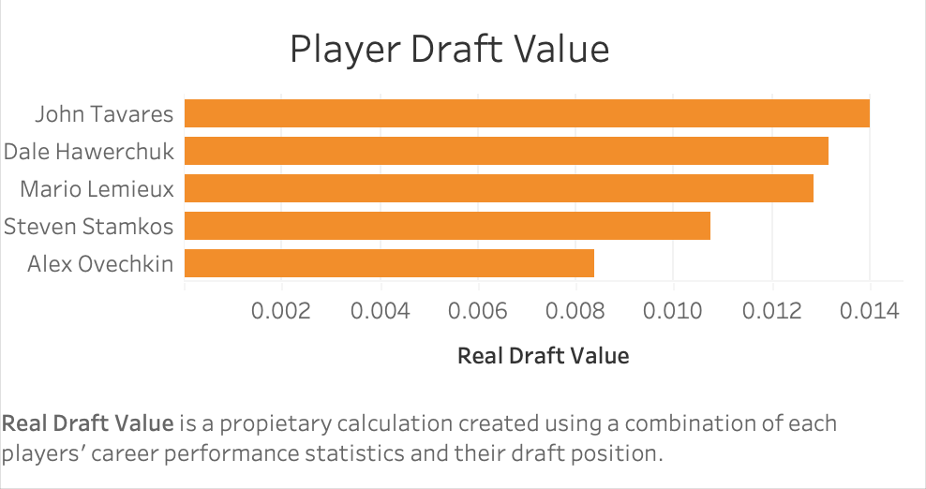
Real Draft Value
Our proprietary player value evaluation allows members to evaluate players not just on performance or draft value, but a unique formulation based on their career performance relative to where they were drafted at.
With our tool you can view the top value players in the league with the click of a button. Wow your friend and steal the show with your insane hockey knowledge

Slide 6
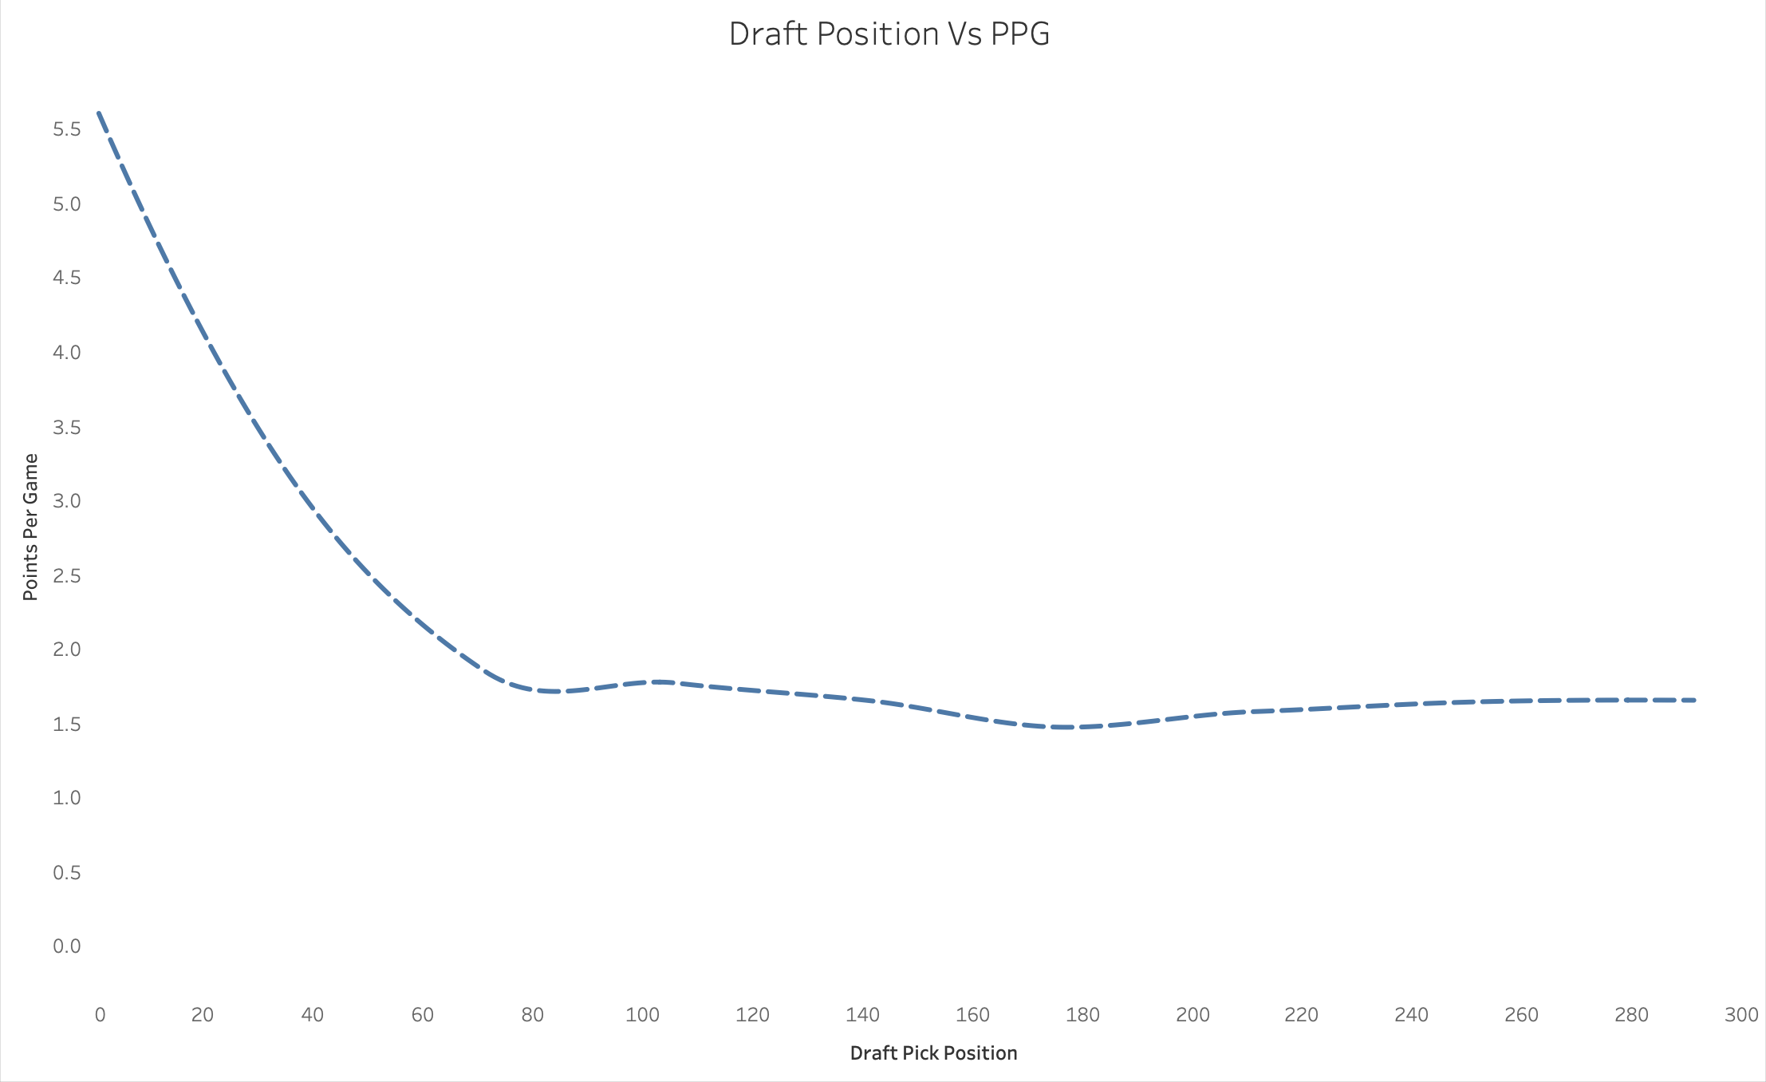
Draft Insights
We all know the first-round pick are heavily sought after, but with our tool you can get the key insights on how to optimally make key late round picks.
Don’t like your teams coach? Become the Coach.

Slide 7
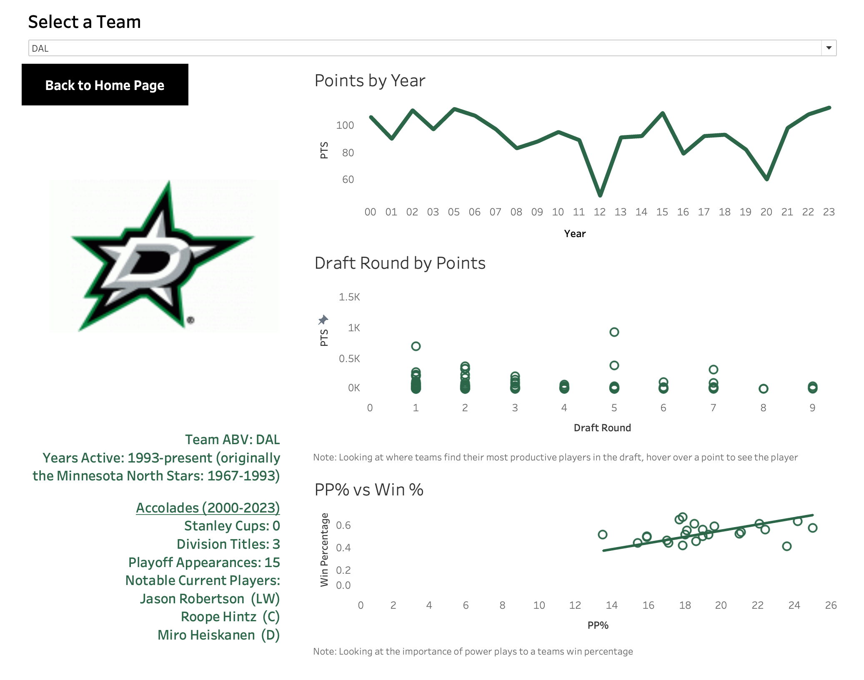
Examine Team success this century
Dynamic Logos and Colors make for a sleek and User-friendly design
Analyze where a team is most successful in the draft
Get a comprehensive team history and rundown of accolades
Analyze the importance of the Power Play

Slide 8
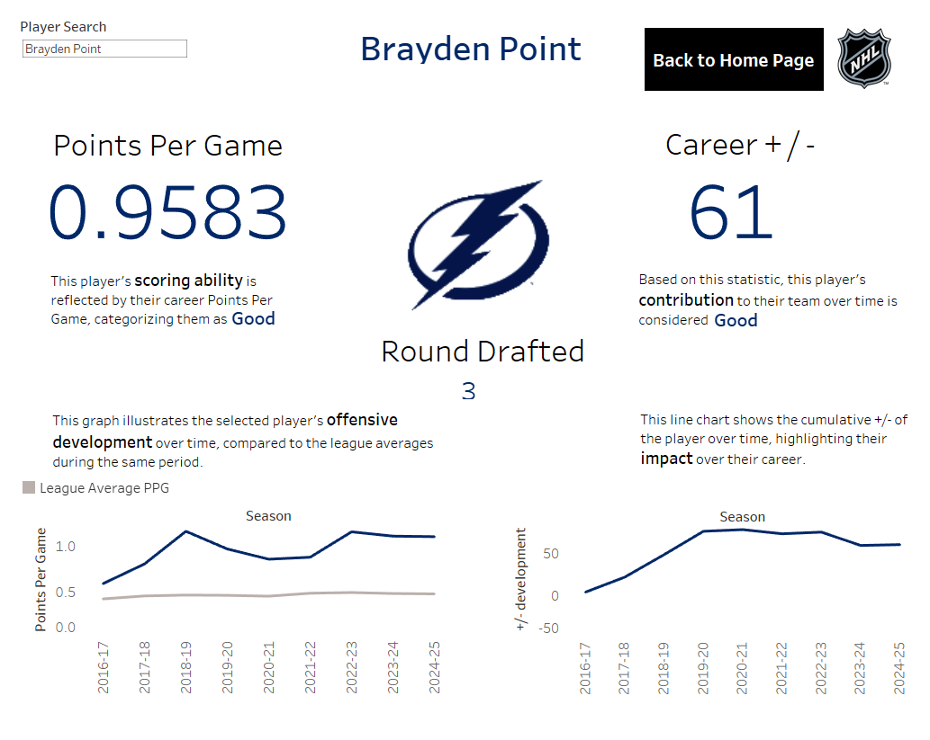
Dynamic logos, statistics, and colors to change with respect to your search
Dynamic player descriptions that explain their skill level
Get an idea of the searched player’s offensive performance against league averages
Analyze the importance of +/- metric evolution over time.

Slide 9
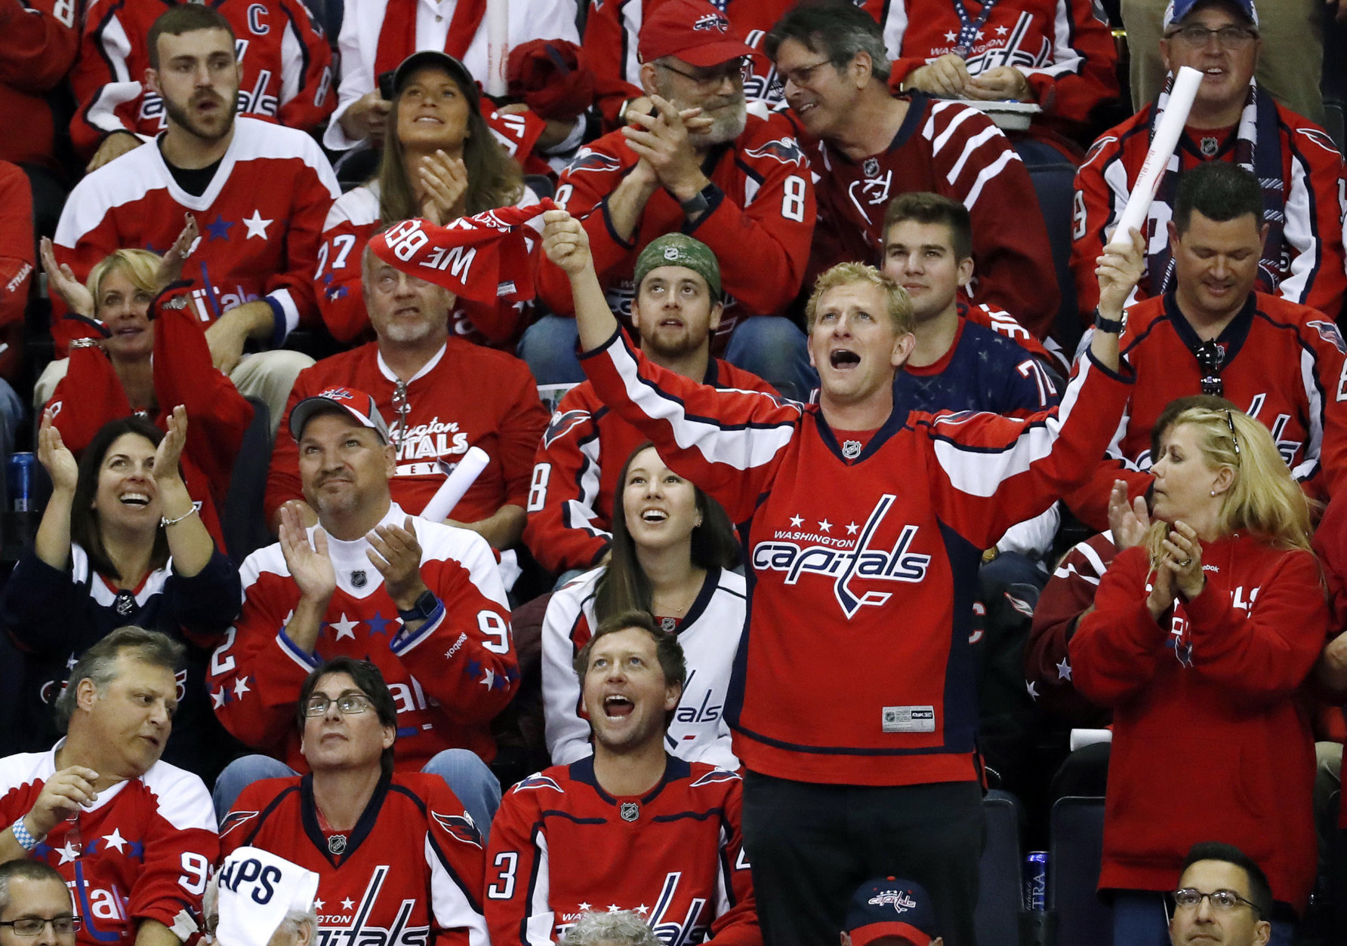
What makes this useful for a fan?
Instant Access to Key Stats
Enhanced Understanding of Player Performance
Compare with League Averages
There’s no longer a need to access multiple sites, it’s all right there

Slide 10
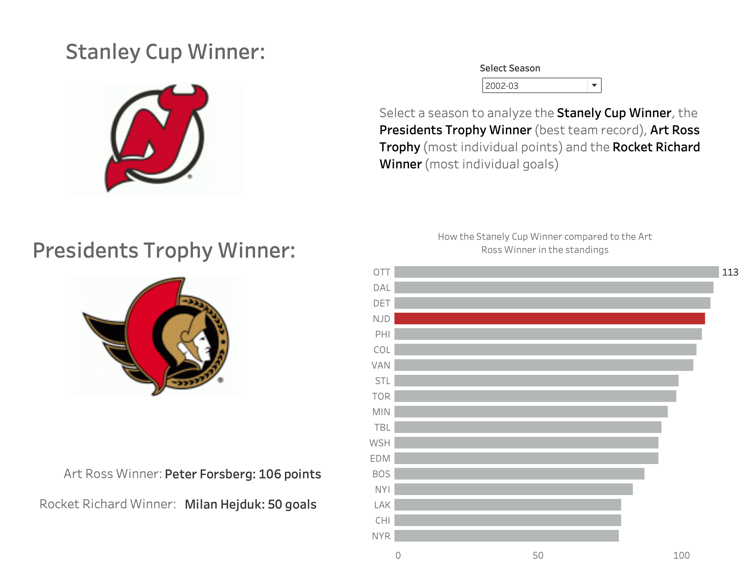
Dynamic Logos to show Stanley Cup and Presidents Trophy Winner that changed based on year being analyzed
Ability to analyze Regular Season success versus Playoff Success
Discover regular season leaders based on chosen season

Slide 11
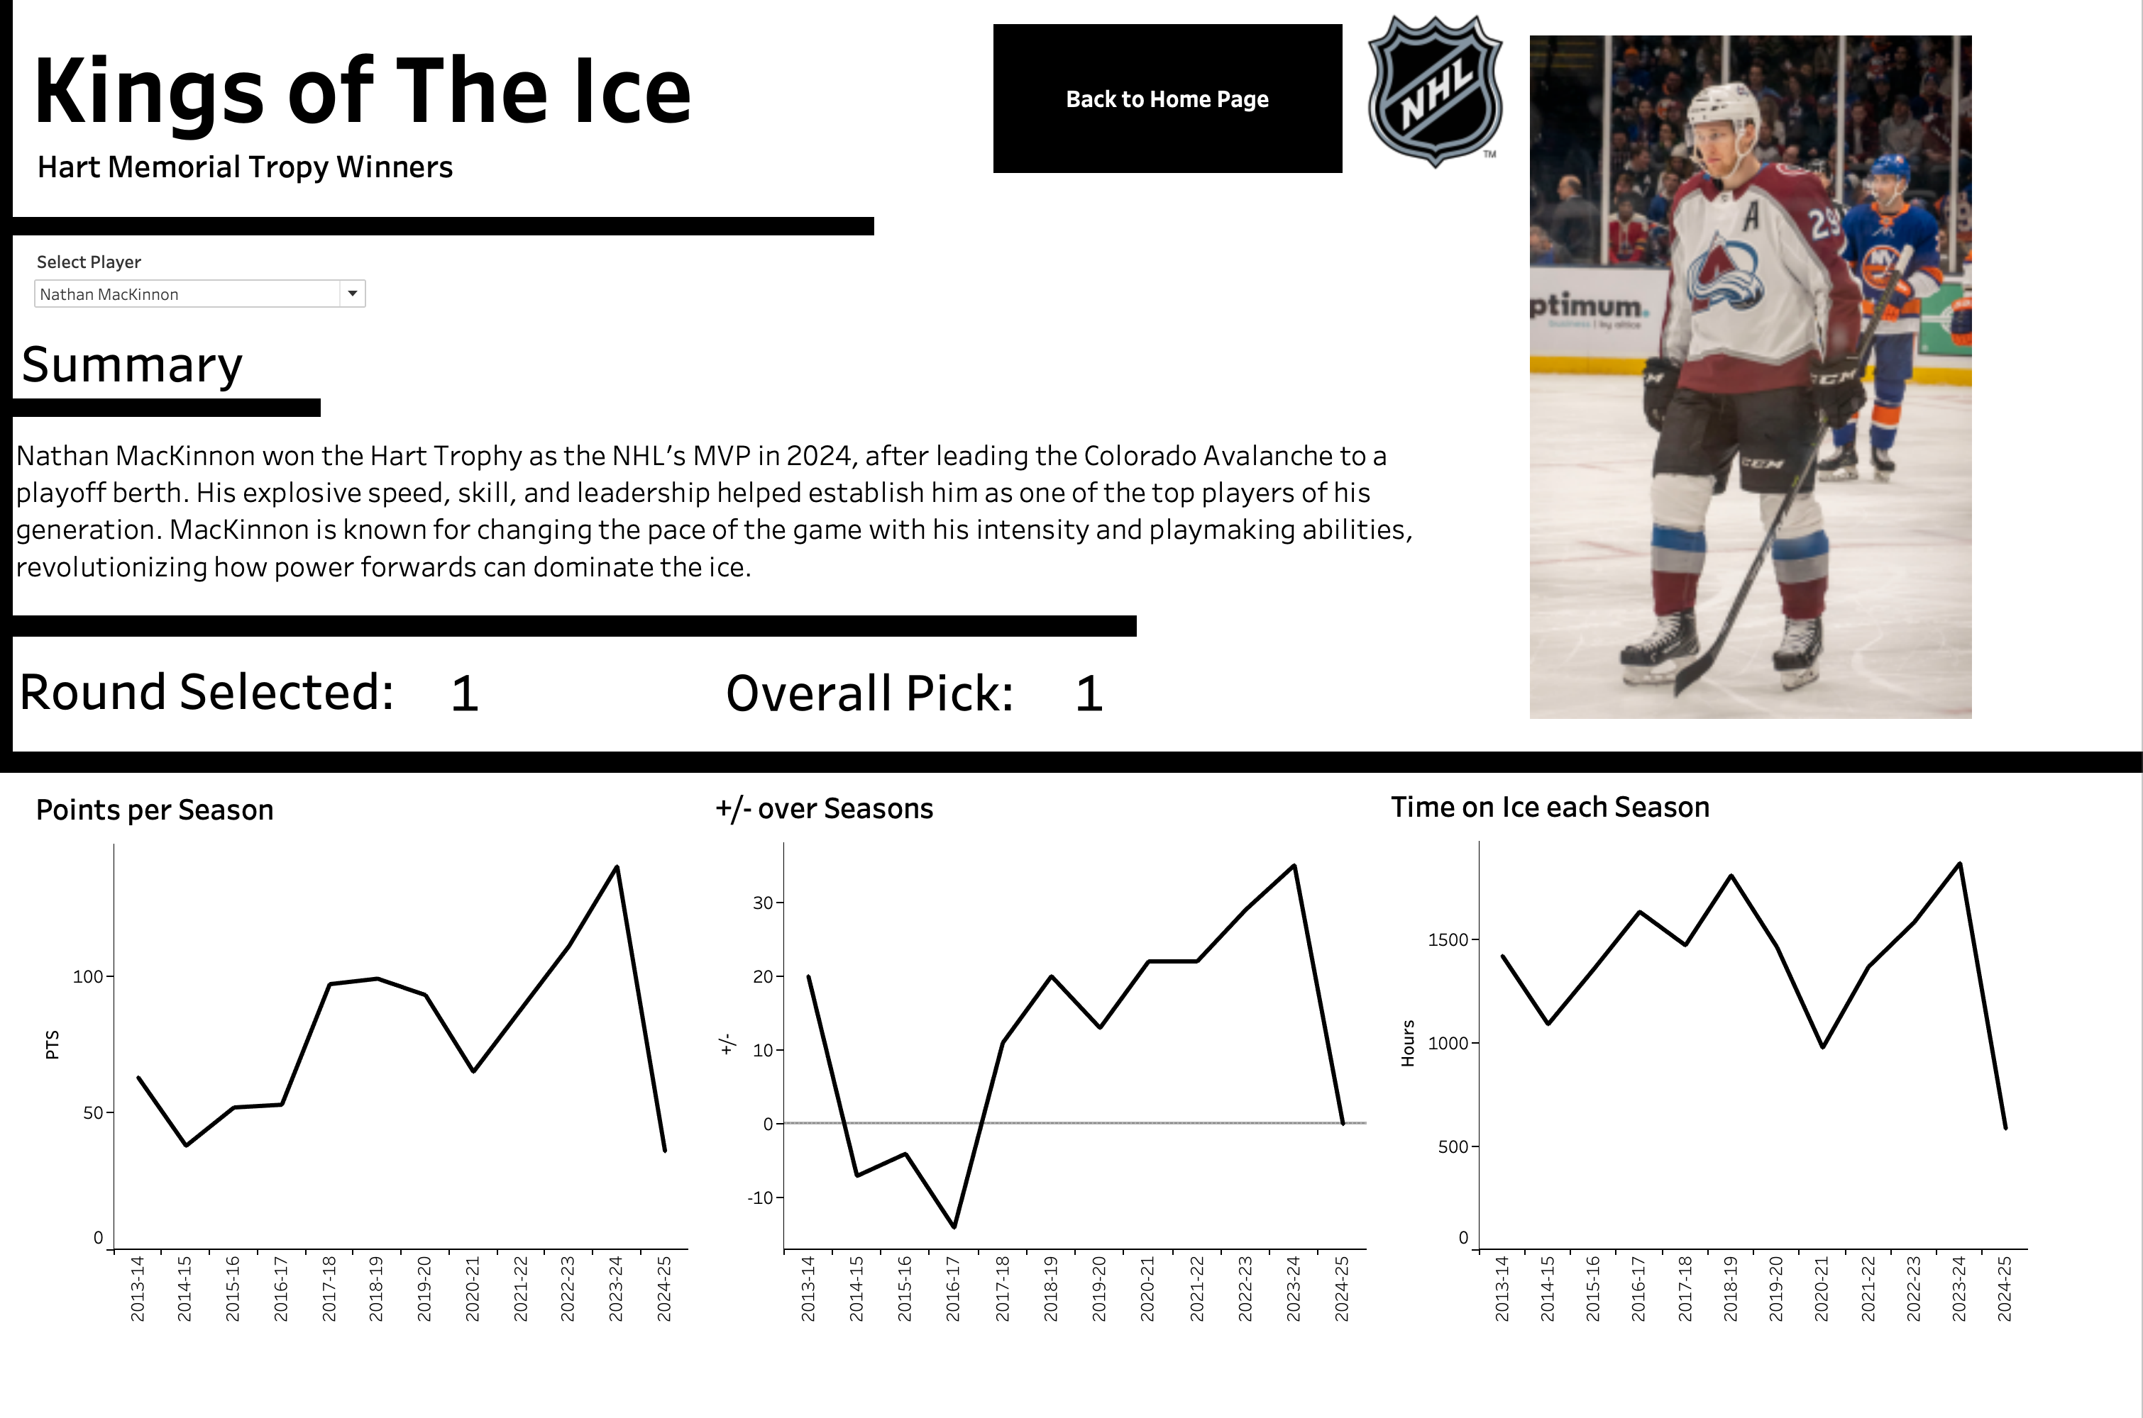
Hart Trophy Winners Analysis
We have also created a tool for more general analysis of the last ten winners of the Hart Memorial Trophy
With this tool more new users can break into hockey analysis more easily by seeing the statistics for the best of the best.

Slide 12

Hart Trophy Winners Analysis
One interesting insight users might find is the overwhelming presence of first round picks
Furthermore, among the first round picked Hart Trophy winners only one wasn’t selected first overall

Slide 13

Conclusion
Player Analysis
Team Overviews
Draft Insights

Slide 14

To take your NHL fandom to the NXT-LVL, invest in our product and Unlock the Power of Insight

Slide 15

Questions?

